Slide 1


Year 13
Futures Information Evening
Tuesday 11th September 2023

Slide 2
Y13 Futures Information

Slide 3

What is an Apprenticeship?
An apprenticeship is a way for young people and adults to earn while they learn in a real job, whilst gaining a real qualification and a real future

Slide 4

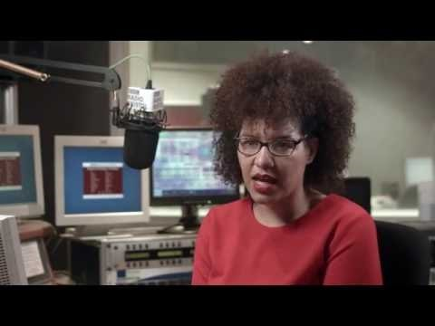
What is an apprenticeship? - VIDEO

Slide 5

Notes:
Over 400 different types of apprenticeships

Slide 6


Slide 7
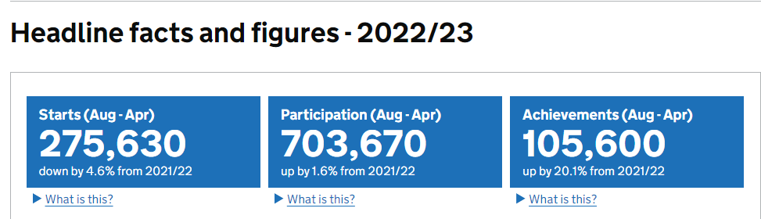
Current UK picture
Notes:
51% of young people don’t go to university – dropped in 17/18 due to the apprenticeship levy
In 2019/20, there were 719,000 people participating in an apprenticeship in England, with 322,500 apprenticeship starts and 146,900 apprenticeship achievements.

Slide 8
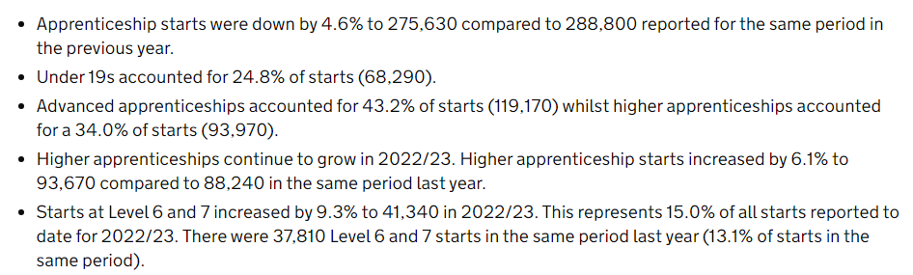
Current UK picture
Notes:
Has been a drop due to the coronavirus pandemic, 33% fall in under 19 starting compared to 2019/20.

Slide 9
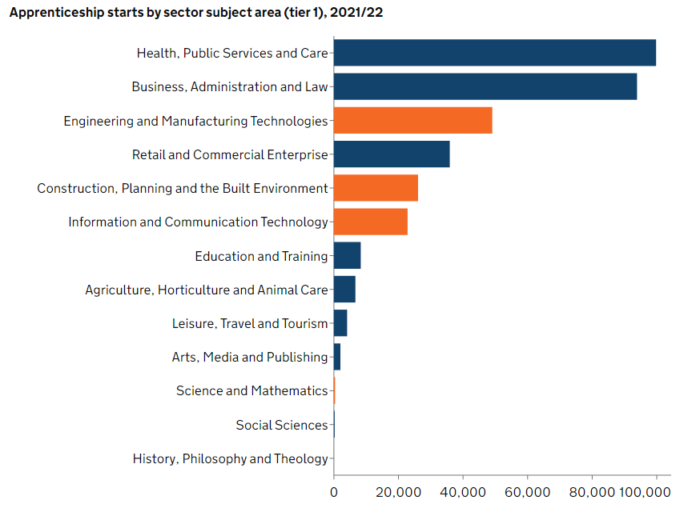
Areas of apprenticeships 2021/22

Slide 10

Apprentice
Training Provider
Employer
Notes:
10

Slide 11
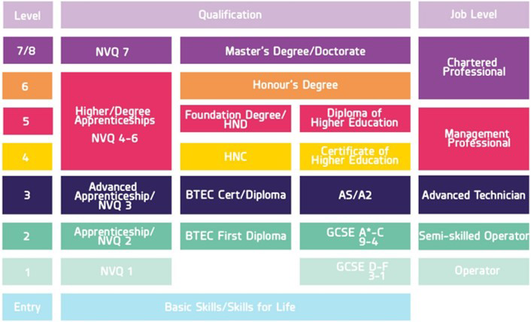
Apprenticeship levels

Slide 12
Degree apprenticeships
What are degree apprenticeships?
Earn a degree while working, earning money while you learn
Your employer covers the cost of your degree
No student debt

Slide 13
Degree apprenticeships
The following website https://www.ratemyapprenticeship.co.uk/degree-apprenticeships#work gives an overview of what degree apprenticeships are available and has the latest up to date degree apprenticeships on offer.
How are degree apprenticeships structured?
80% on the job training
20% spent at university.
This might involve day-release or blocks of time spent at university
It might take up to 5 years to get your degree.

Slide 14
Where can I find vacancies?
All apprenticeships are advertised on the government website
https://www.findapprenticeship.service.gov.uk/apprenticeshipsearch

Slide 15
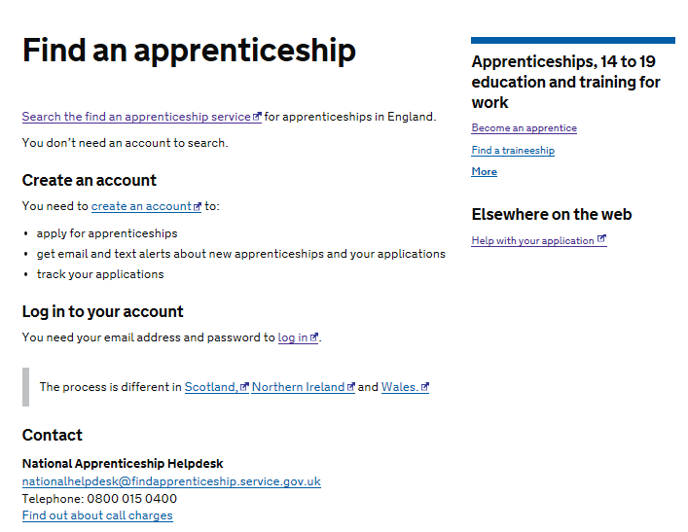
www.gov.uk/apply-apprenticeship
Gov.uk – register, get email and text alerts!

Slide 16
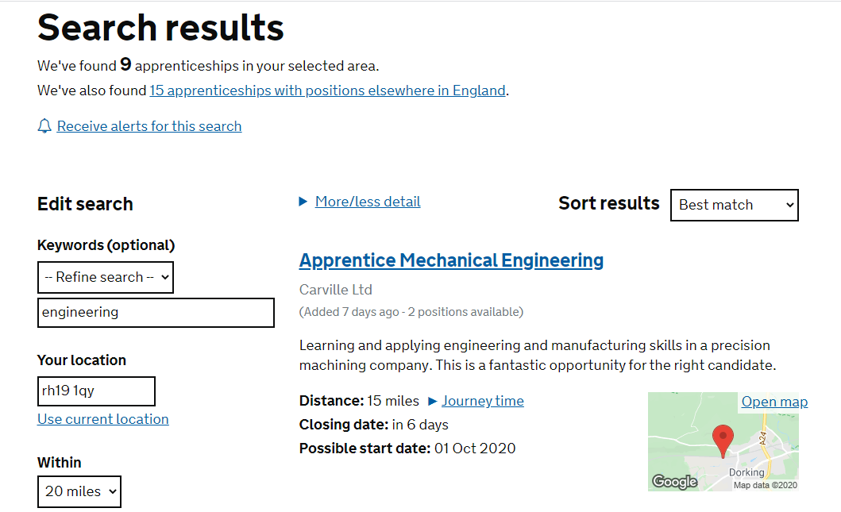

Slide 17
Higher and degree vacancy listing
Visit https://amazingapprenticeships.com/app/uploads/2022/11/Higher-Degree-Listing-FEB-2023.pdf
Next update expected November 2023

Slide 18

UCAS and ucas hub– allows you to search for apprenticeship
https://www.ucas.com/apprenticeships
https://careerfinder.ucas.com/
Notes:
New for 2016 – can filter search to include only apprenticeships

Slide 19
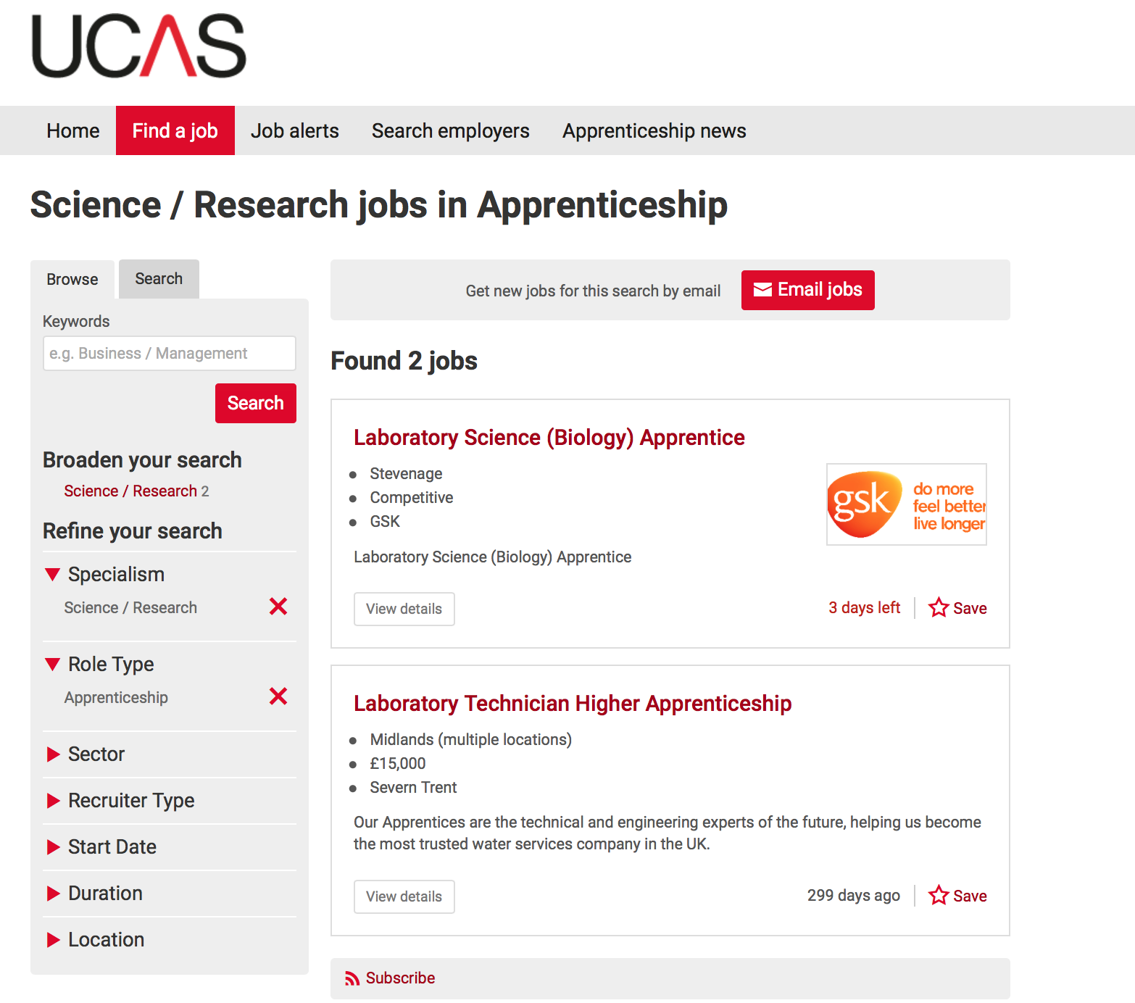
Notes:
New for 2016 – can filter search to include only apprenticeships

Slide 20
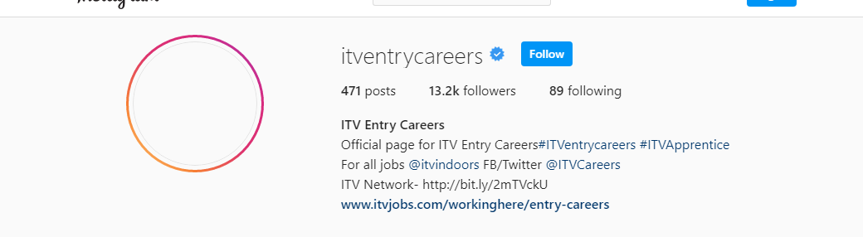
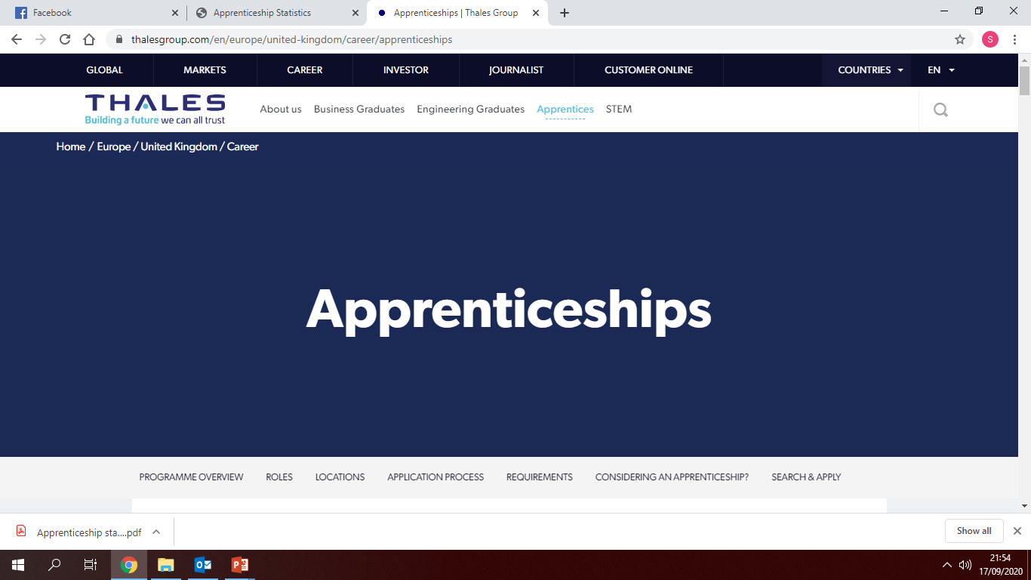
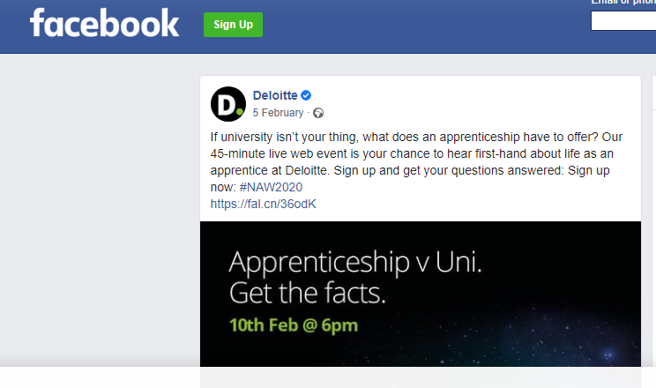
Individual company websites and social media platforms

Slide 21
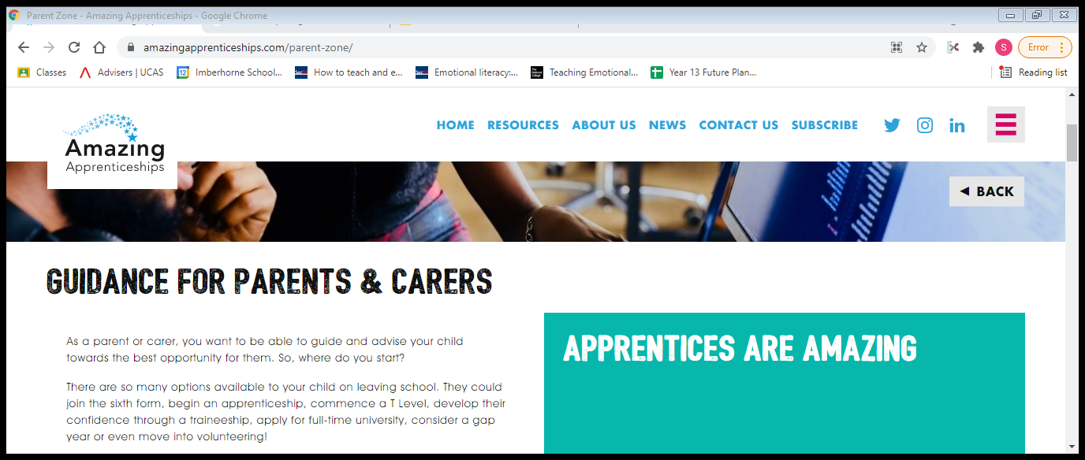
Amazing apprenticeships – parent zone
https://amazingapprenticeships.com/parent-zone/

Slide 22
Really useful websites
http://www.allaboutschoolleavers.co.uk/
  This has the top 100 employers for apprenticeships and school leaver programmes
www.notgoingtouni.co.uk
http://schoolleavers.milkround.com/
http://www.apprenticeshipguide.co.uk
  These are updated on a daily basis
  You can receive email alerts to new opportunities
  They contain lots of useful information from completing an application to preparing for interview
Also keep an eye on individual company websites and social media platforms
Notes:
I find all about school leavers really useful

Slide 23
Key tips to securing an apprenticeship/school leaver programme
Regularly search the apprenticeship/school leaver programmes websites – sign up for alerts, make sure you are aware of closing dates.
Apply for more than one vacancy – many apprenticeships are in high demand
Be prepared to complete applications forms, send in CV’s, complete online psychometric test and other tests, attend interviews (phone, face to face, group)
Always tailor your application to the organisation you are applying for – it should be unique
Don’t be put off if you are not successful, look at other businesses you can target

Slide 24
Covering letter workshop – Wednesday 6th September
Personal Development Programme
  Where to look for an apprenticeship
  Application forms/CV’s/Covering letters
  Video interviews/online tests
  Mock assessment centres/Interview practice
  Apprenticeship bulletin – published half termly throughout Y13
One-to-one career interviews as required

Slide 25


National apprenticeship show
https://nationalapprenticeshipshow.org/london-se/

